Slide 1




Baseball & Beer
Team Performance, Attendance, Population, and What you pay for beer in an mlb stadium from 2013-2015
Image credit Vecteezy, Pumashoeme, and momentbloom at www.vecteezy.com/free-vector/money

Slide 2
Hypothesis:
Beer prices will go down with better attendance and better attendance should correlate to team performance

Slide 3
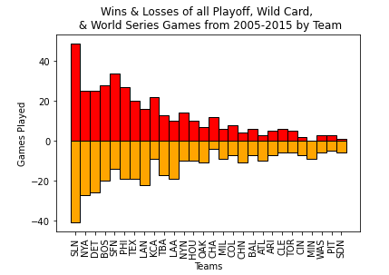
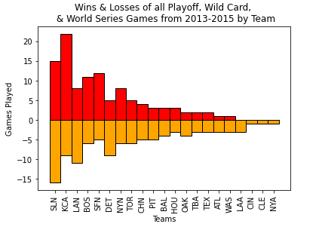
Playoff Team Performance

Slide 4
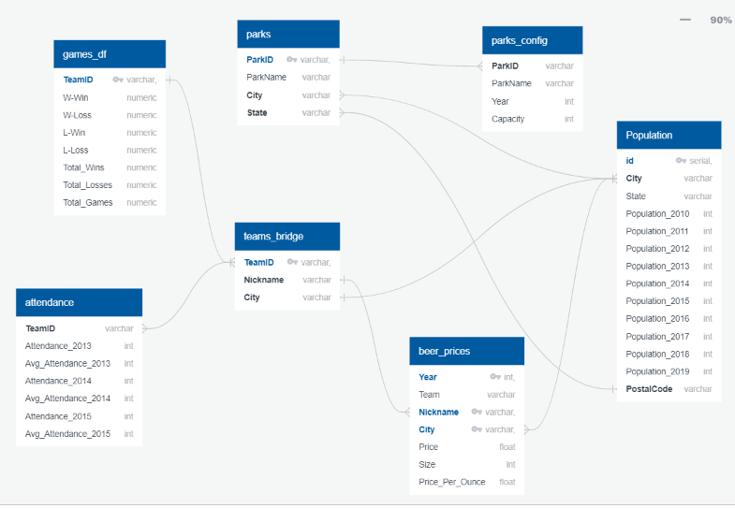
Diagram of Tables (Extract)
Sources:
Beer Prices: Data.World
Attendance: Baseball_reference.com
US Population: Census.org
Teams Bridge, Parks, Parks Config: Kaggle.com

Slide 5

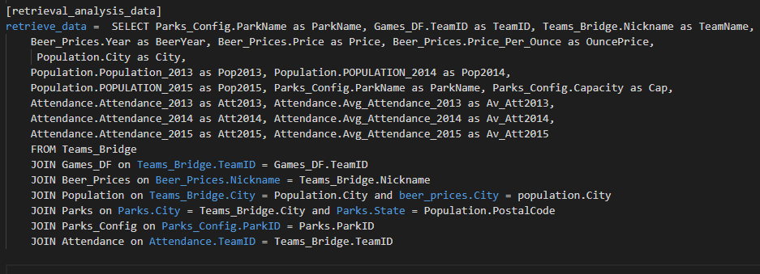

Data Transformation
*INTERNAL SCREAMING*
Done via psycopg2 package, utilizing database.ini file to store all SQL and config.py file to build an upload engine (very easy, SQL statements is not necessary with the psycopg2, but we did it to have a better control over our code)
Lessons Learned:
Normalize data on Foreign Key columns
Data will be messy - misspelled words, different acronyms, etc - check before
Commit commit commit!
Start from the end: what question exactly are we exploring? Approximately what query will give us the desired result? What tables we need to support our research? (in about this order)
Hint: in order to serve our research purpose the DB or data doesn't have to be perfect

Slide 6

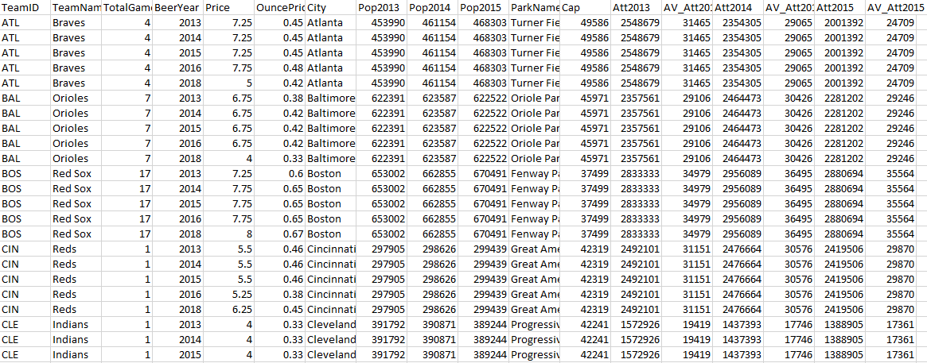
After Clean Up (Load)

Slide 7
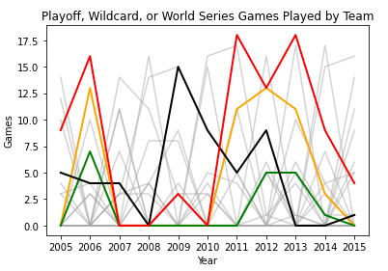
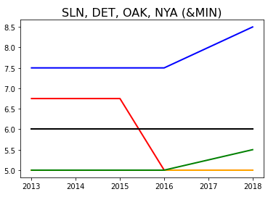
Team Performance & Beer Prices

Slide 8
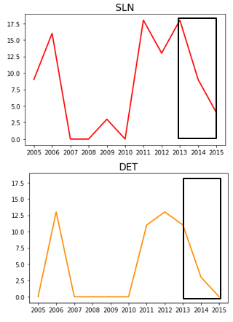
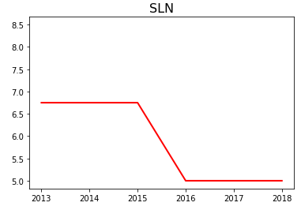
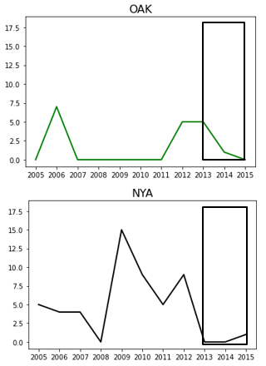
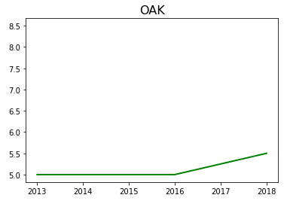
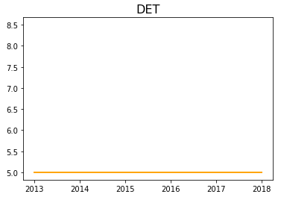
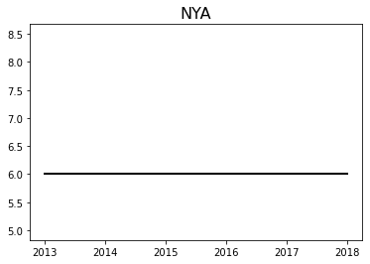
Team Performance & Beer Prices Broken Down

Slide 9
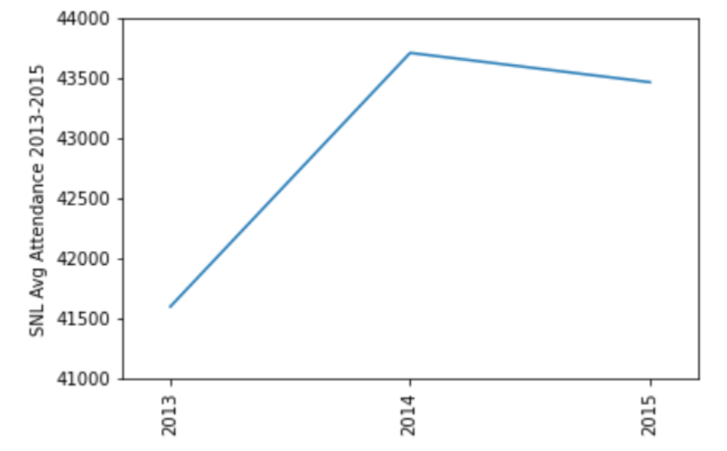
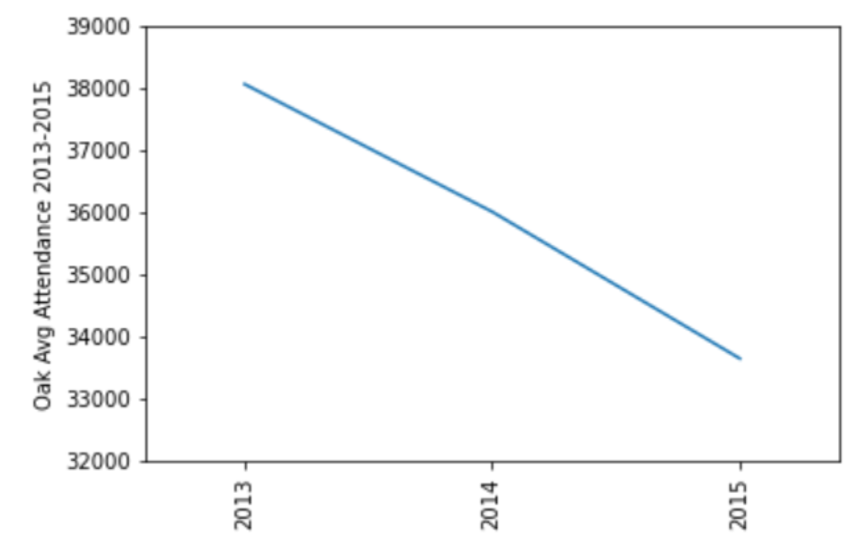
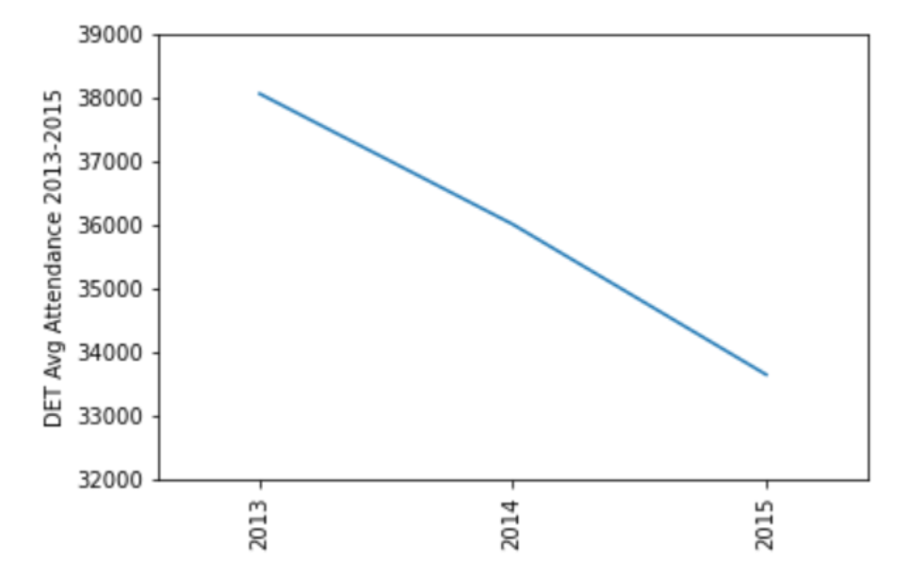
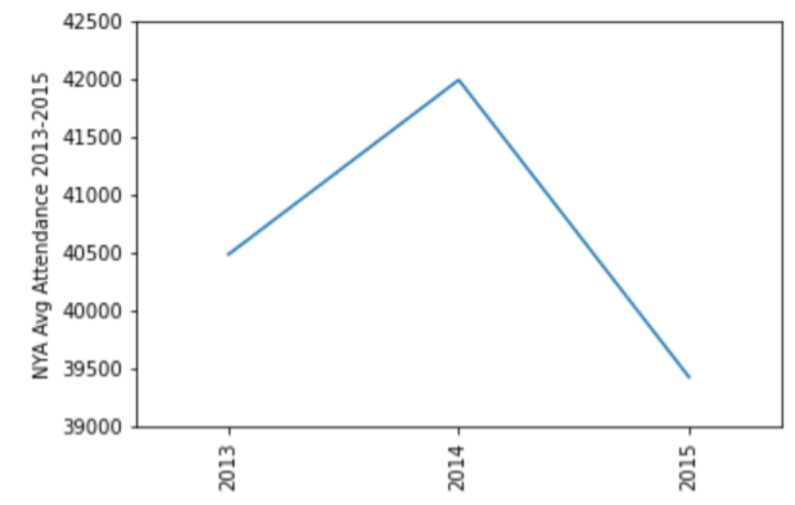
Attendance & Beer Prices Broken Down

Slide 10
Conclusions and Limitations
Hypothesis Answers:
There are many factors that go into beer cost at stadiums, but they may have more to do with local tastes/markets than winning performance
There may be an inverse connection between attendance and beer, but there is a floor for beer prices. Better teams do appear to have cheaper beer, but this is a weak connection. With more time we would look more into population, stadium capacity, and perhaps even availability of craft vs. domestic beers. WE NEED MORE FIELD RESEARCH AND WE VOLUNTEER (once the pandemic is over).
Project Overview:
Biggest challenge was normalizing data and cleaning it (no surprise there)
It helps to test affects of every change – sometimes edits made to one table or code of piece impacted the connection to another

